Slide 1
Requirements Engineering
<number>

Slide 2
Need
A customer walks into your office, sits down, looks you straight in the eye and says,
“I know you think you understand what I said, but what you don’t understand is what I said is not what I mean.”
And this is said very late in your projects.
Requirement engineering helps you to better understand the problems.
<number>

Slide 3
Requirements Engineering Tasks
Inception—Establish a basic understanding of the problem and the nature of the solution.
Elicitation—Draw out the requirements from stakeholders.
Elaboration—Create an analysis model that represents information, functional, and behavioral aspects of the requirements.
Negotiation—Agree on a deliverable system that is realistic for developers and customers.
Specification—Describe the requirements formally or informally.
Validation—Review the requirement specification for errors, ambiguities, omissions, and conflicts.
Requirements management—Manage changing requirements.
<number>

Slide 4
Inception
Ask “context-free” questions
Who is behind the request for this work?
Who will use the solution (product/system)?
What will be the economic benefits?
How would you characterize “good” output from the system?
What problems does this solution address?
What environment will the product be used in?
Are you the right person to answer these questions?
Are these question relevant?
Can anyone else provide additional information?
Should I be asking you anything else?
<number>

Slide 5
Eliciting Requirements
Why is it so difficult to clearly understand what the customer wants?
Scope
The boundary of the system is ill-defined.
Customers/users specify unnecessary technical detail that may confuse rather than clarify objectives.
Understanding
Customers are not completely sure of what is needed.
Customers have a poor understanding of the capabilities and limitations of the computing environment.
Customers don’t have a full understanding of their problem domain.
Customers have trouble communicating needs to the system engineer.
Customers omit detail that is believed to be obvious.
Customers specify requirements that conflict with other requirements.
Customers specify requirements that are ambiguous or untestable.
Volatility
Requirements change over time.
<number>

Slide 6
Collaborative Requirements Gathering
Meetings are attended by all interested stakeholders.
Rules established for preparation and participation.
Agenda should be formal enough to cover all important points, but informal enough to encourage the free flow of ideas.
A facilitator controls the meeting.
A definition mechanism (blackboard, flip charts, etc.) is used.
During the meeting:
The problem is identified.
Elements of the solution are proposed.
Different approaches are negotiated.
A preliminary set of solution requirements are obtained.
The atmosphere is collaborative and non-threatening.
<number>

Slide 7
Elicitation Work Products
Statement of need and feasibility.
Statement of scope.
List of participants in requirements elicitation.
Description of the system’s technical environment.
List of requirements and associated domain constraints.
List of usage scenarios.
Any prototypes developed to refine requirements.
<number>

Slide 8
Use-Cases
A use-case scenario is a story about how someone or something external to the software (known as an actor) interacts with the system.
Each scenario answers the following questions:
Who is the primary actor, the secondary actor(s)?
What are the actor’s goals?
What preconditions should exist before the story begins?
What main tasks or functions are performed by the actor?
What exceptions might be considered as the story is described?
What variations in the actor’s interaction are possible?
What system information will the actor acquire, produce, or change?
Will the actor have to inform the system about changes in the external environment?
What information does the actor desire from the system?
Does the actor wish to be informed about unexpected changes?
<number>

Slide 9
Elements of the Analysis Model
Scenario-based elements
Use-case—How external actors interact with the system (use-case diagrams; detailed templates)
Functional—How software functions are processed in the system (flow charts; activity diagrams)
Class-based elements
The various system objects (obtained from scenarios) including their attributes and functions (class diagram)
Behavioral elements
How the system behaves in response to different events (state diagram)
Flow-oriented elements
How information is transformed as if flows through the system (data flow diagram)
<number>

Slide 10
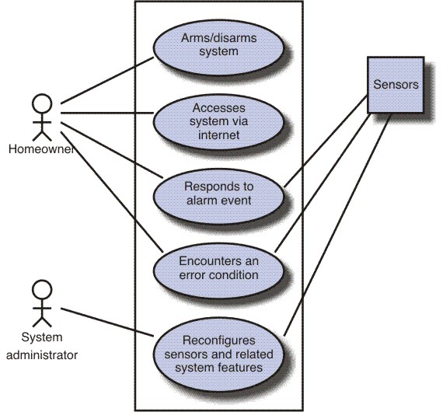
Use-Case Diagram
<number>

Slide 11
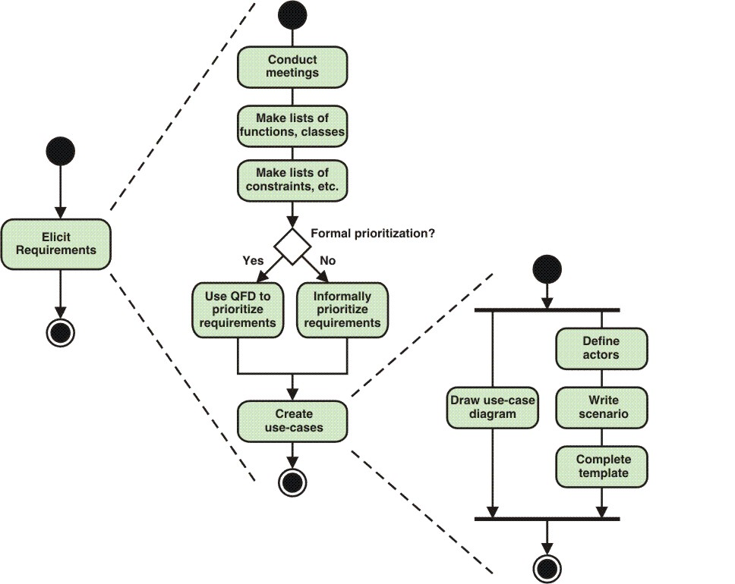
Activity Diagram for RE
Quality Function Deployment (QFD) is a structured approach to defining customer needs or requirements and translating them into specific plans to produce products to meet those needs.
<number>

Slide 12
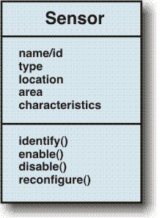
Class Diagram
<number>

Slide 13
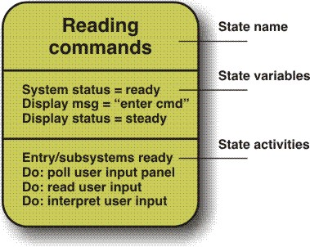
State Diagram
<number>

Slide 14
Negotiating Requirements
Identify the key stakeholders
These are the people who will be involved in the negotiation
Determine each of the stakeholders “win conditions”
Win conditions are not always obvious
Negotiate
Work toward a set of requirements that lead to “win-win”
<number>

Slide 15
Specifying Requirements
Can be
Written document
A set of graphical models
A collection of usage scenarios
A prototype
Or any combination of these
<number>

Slide 16
Validating Requirements
Is each requirement consistent with the objective of the system?
Have all requirements been specified at the proper level of abstraction?
Is the requirement really necessary?
Is each requirement bounded and unambiguous?
Does each requirement have attribution?
Do any requirements conflict with other requirements?
Is each requirement achievable in the system’s technical environment?
Is each requirement testable, once implemented?
Does the model reflect the system’s information, function and behavior?
Has the model been appropriately “partitioned”?
Have appropriate requirements patterns been used?
<number>

Slide 17
Requirement Management
Set of activities to help the project team to Track, Identify and Control the changes in the requirement.
<number>

Slide 18
End
<number>
Notes:
<number>

